Slide 1
Mirsharai:
The New Economic Geography of Bangladesh
Explore your investment in Economic Zones Your Investment - Our Care...
Mohammed Shoheler Rahman Chowdhury
Manager, BEZA
Consultant

Slide 2
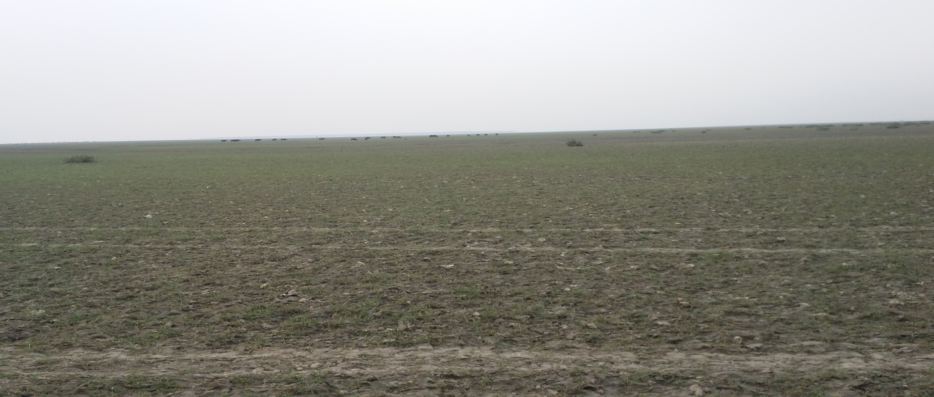
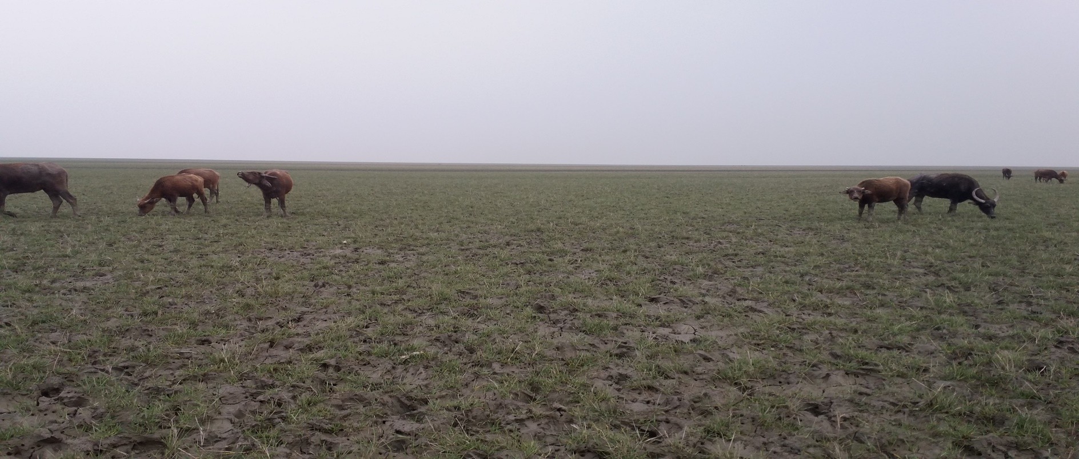
Mirsharai in 2015

Slide 3
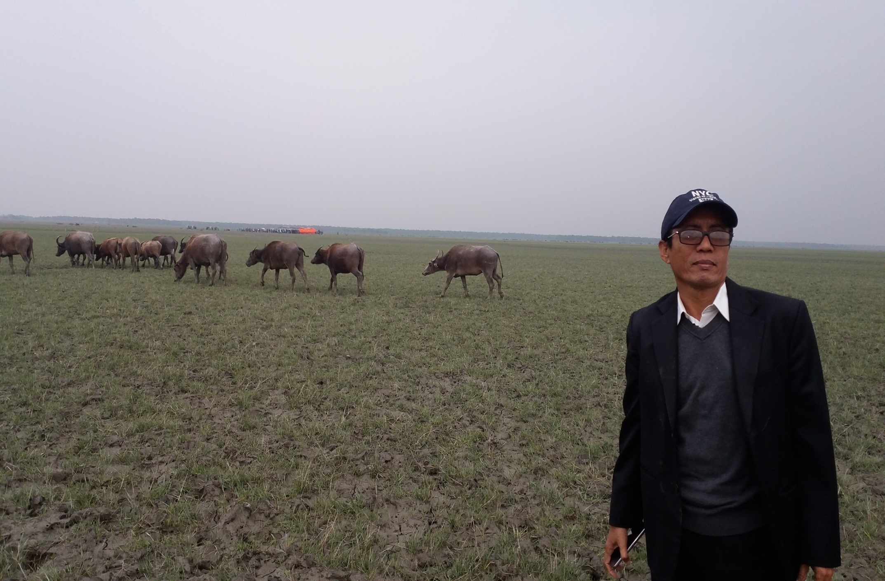
The transformation started

Slide 4
Our Mission: Mirsharai Integrated Industrial City
Establishment of 25 Economic Zones over 30,000 acres of land with all facilities for work-life balance
Employment generation for 2 million people
Additional exports of USD 5 billion per year

Slide 5
Development approach
Public provision of off-site infrastructure and facilities
Secured land title and development rights by the government for lease to private zone developer
BEZA can provide land to investors at predetermined rate of tariff
Expansion of activities to include commercial and professional services
Equal treatment to foreign and local investors and to various forms of investment
Provision of incentives for private zone developers
Allowing zone developers and others to supply utility services to tenants of zone
Treatment of sales of goods and services from the domestic market to zones as “constructive exports” eligible for all relevant export incentives

Slide 6
Mirsharai Integrated Industrial City
Competitive advantages
Strategic location: Along the Dhaka-Chittagong economic corridor Easy access: 67 km from Chittagong port 182 km from Dhaka 79 km from Chittagong Airport
Utilities are available
Support industries are available
Skill workforce are available
.

Slide 7
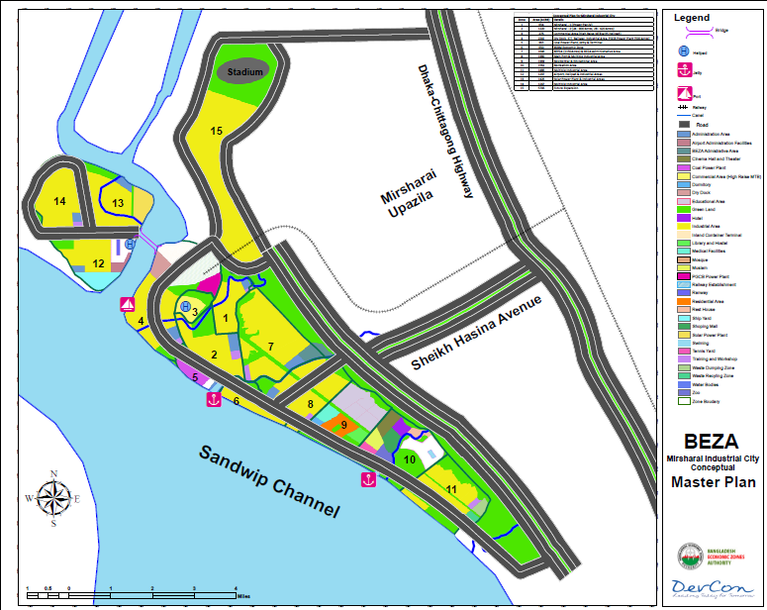
Indicative Master Plan of Mirsharai Integrated industrial City

Slide 8
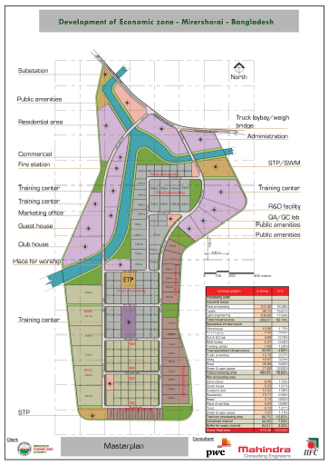
Mirsharai EZ (1st Phase)
Proposed area
550 acre
Developer appointment
6.5 km approach road
Employment Creation
~1,00,000 workers
The selection of developer for Mirsarai EZ (1st Phase) is almost complete.
Current Development
Land development
Electricity connection
Embankment construction
Pipeline water connection

Slide 9
Mirsharai EZ (2nd Phase )
Proposed area
1300 acres
Construction of 19 KM protection embankment by BWDB
Employment Creation
~5,00,000 workers
Current Development
230 KVA Grid Sub-station by PGCB
4 lane Approach Road by RHD
200 MMCFD Gas Line construction by KGDCL
Potential investors showing interest
Investors from home and abroad are showing interest for investment in this economic zone.

Slide 10
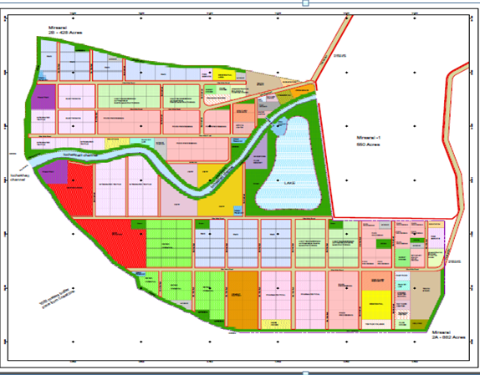
Mirsharai EZ-2 : Master Plan

Slide 11
Mirsharai EZ-2 development works
Name of Package | Estimated Cost (in BDT Crore )
Site development & construction of Embankment for Mirsarai-2A EZ | 264.68
Site development & construction of Embankment for Mirsarai-2B EZ | 156.5
Construction of Administrative Building | 32
Construction of Access Road (3.5 km) | 22.47
Construction of bridge and culvert | 25.00
Construction of 33/11 KV Sub-station | 12.00
External water supply | 8.00
Construction of 16 vent sluice gate at the Ichakhale channel | 29.22
Total | 549.87

Slide 12
Investment for Mirsharai Integrated Industrial City
Package | Cost (BDT. Crore) | Implementing Authority | Progress
10 KM 4 lane approach road from Chittagong Highway to Mirsarai EZ | 124 | Roads and Highways Department | Appointed contractor for construction of 18 Culvert/ Bridge . Contractor for road construction works will start soon.
230 KV Grid Station in Mirsarai EZ | 450 | Power Grid Company of Bangladesh | BEZA provided 50 acres land for PGCB grid substation DPP approval is in progress in the Planning Commission
LNG Gas Connection project to Mirsarai EZ | 289.88 | Karnaphuli Gas Distribution Company Ltd | Karnaphuli Gas Distribution Company Ltd. submitted a DPP to Petrobangla for LNG connection to Mirsarai EZ.
Total | 2346.88

Slide 13
Investment for Mirsharai Integrated Industrial City
Package | Cost (BDT.Crore) | Implementing Authority | Progress
Mirsarai EZ Protection Embankment to be constructed by BWDB | 1183.00 | Bangladesh Water Development Board | ECNEC approved the project on August 2016. BWDB will develop the project with the help of Bangladesh Navy. Bangladesh Navy will start the construction work soon.
Construction of Mini Sea Port Besides Mirsarai EZ |  | Chittagong Port Authority | Chittagong Port Authority published Request for Expression of Interest for appointment of feasibility study consultant.
Railway connection to Mirsarai EZ |  | Bangladesh Railway | Bangladesh Railway started primary assessment for rail line connection to EZ
Total | 2346.88

Slide 14
Bangladesh Economic Zones: Incentives
Incentives For Developers
Income Tax exemption : 100% for the first 10 years; 70% for 11th year; 30% for the 12th year.
Exemption from import duty, regulatory duty, supplementary duty and VAT on all goods for development of economic zone (except locally available construction goods)

Slide 15
Bangladesh Economic Zones: Incentives
Incentives For Developers
Exemption of stamp duty and registration fees for land registration for the first time
Exemption of stamp duty and registration fees for registration of loan/credit document
Exemption from dividend tax

Slide 16
Bangladesh Economic Zones: Incentives
Incentives For Unit Investors
Income Tax exemption : 100% for first 3 years;
80% for 4th year; 70 % for 5th year; 60% for 6th year; 50% for 7th year; 40% for 8th year; 30 %for 9th year and 20% for 10th year.
Exemption from import duty, regulatory duty, supplementary duty and VAT on all capital machinery and raw materials (except locally available construction goods)

Slide 17
Bangladesh Economic Zones: Incentives
Incentives For Unit Investors
Tax exemption on royalties, technical fees etc.
Tax exemption on capital gains from transfer of shares

Slide 18
Non-fiscal incentives
100% foreign ownership permissible
Foreign currency loan allowed in compliance with existing laws
Sub-contracting with Domestic Tariff Area allowed
No ceiling on foreign investment
Full repatriation of capital and dividend
Hold nonresident foreign currency deposit account
Products of EZs will enjoy DFQF access to major markets of the world
Transfer of shares of foreign shareholders allowed
50 years land lease period with scope of extension

Slide 19
One Stop Service
Draft law on OSS was approved by the Governing Board of BEZA.
BEZA has identified 31 services to be provided under the One Stop Service Centre.
JICA is supporting BEZA to install OSS facilities in BEZA.

Slide 20
Mirsharai Integrated Industrial City
Potential Industries | Garments and garments accessories Integrated textile industry Motorbike assembling Automobile assembling Automobile parts manufacturing LPG plant Power plant Shipbuilding Ceramics Pharmaceutical Light engineering Leather products and footwear etc
.

Slide 21
Potential benefits of the economic zone
 | Direct benefits | Indirect benefits
Foreign exchange earnings
FDI
Employment generation
Government revenue
Export growth
Skill upgrading
Technology transfer
Demonstration effect
Export diversification
Enhancing trade efficiency of domestic firms

Slide 22
The Challenges
Balancing competitiveness with sustainable wages and working condition
Diversification
Upgradation

Slide 23
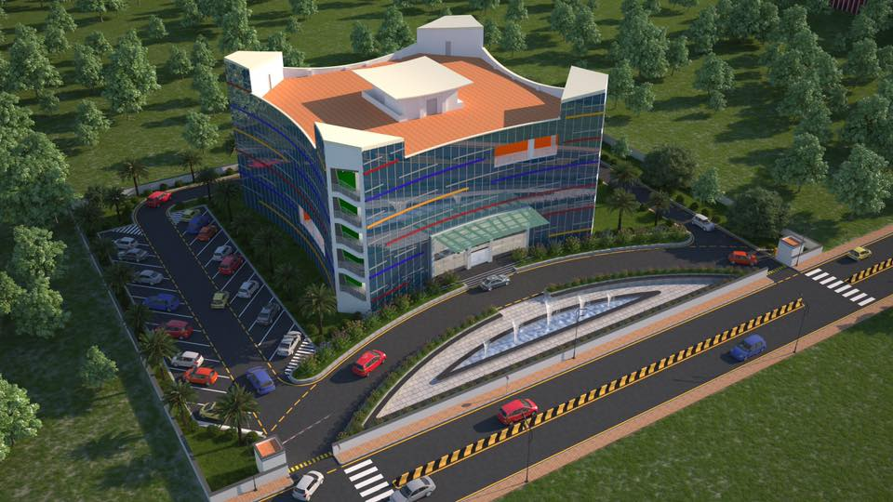
Administrative Building Design

Slide 24
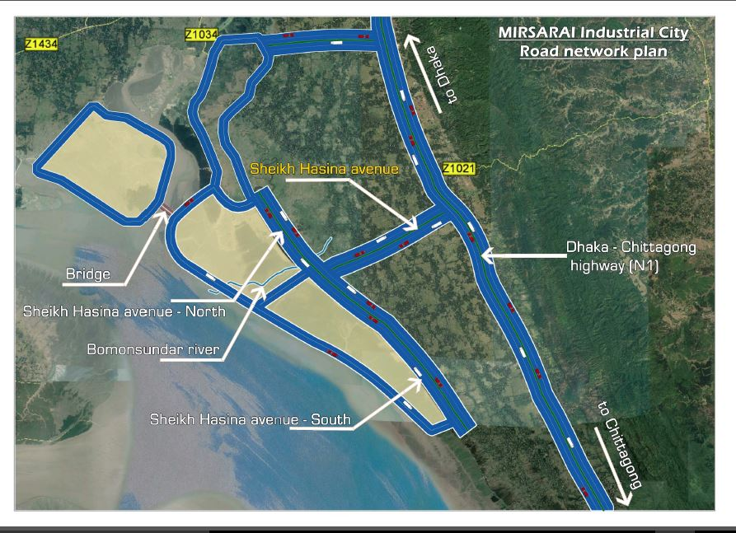
4 lane Road Network plan for Mirsharai Industrial City

Slide 25
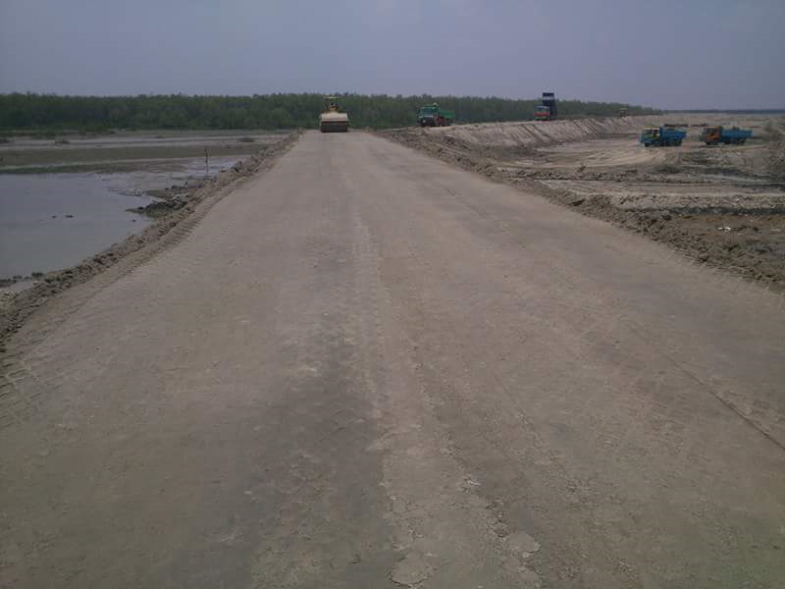
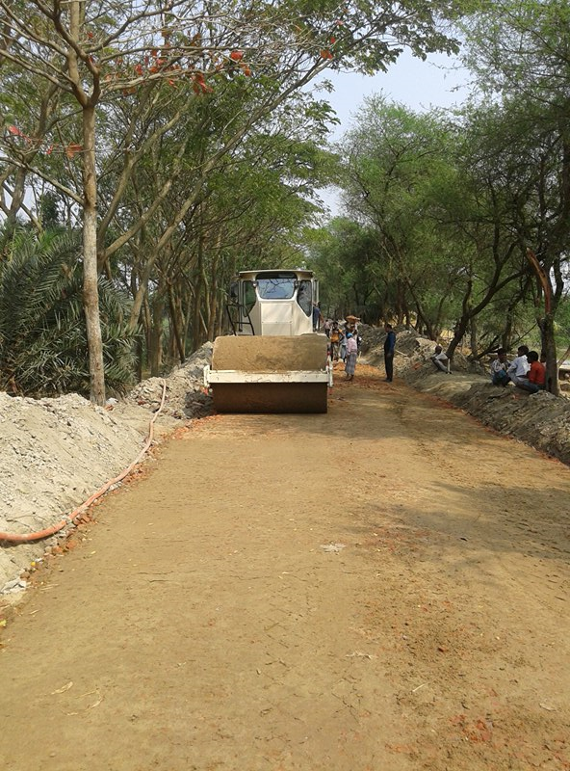
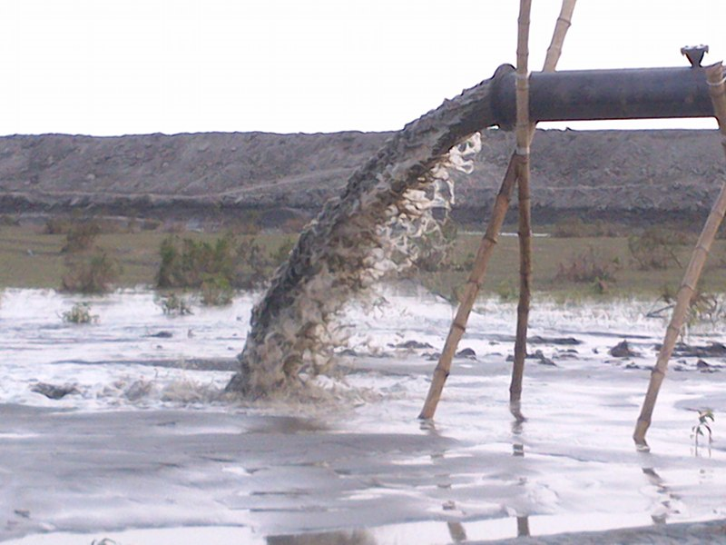
Development activities of Mirsharai EZ
Approach Road Development
Land Development
Embankment Development

Slide 26
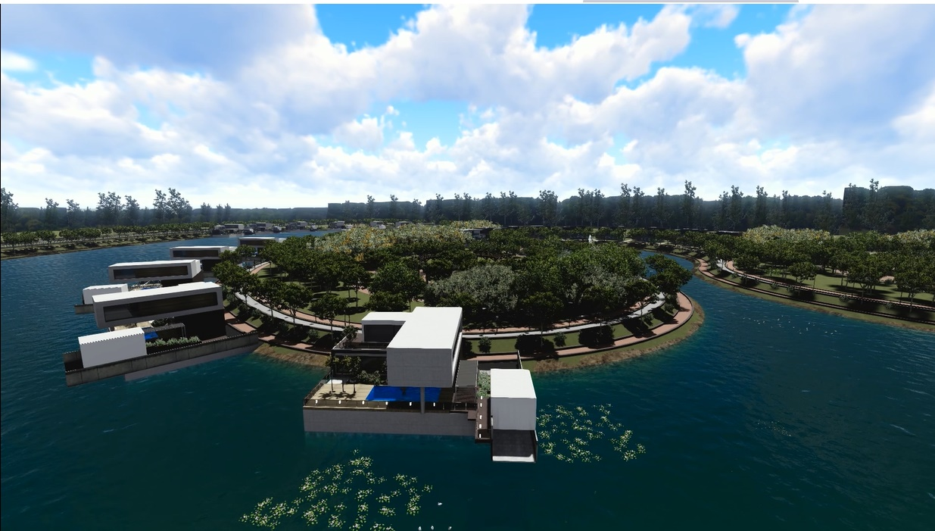
Panoramic view of Lake

Slide 27
???

Slide 28
Thank You

