Slide 1

TOURISM ECONOMIC ZONES
unlocking
the tourism potentials
Presenter
Mr. Md. Mijanur Rahman
Director (Commercial) (Joint Secretary)
Bangladesh Parjatan Corporation

Slide 2
Tourism Potentials of Bangladesh
Bangladesh has experienced a continuous growth in tourist arrivals and departures.
In 1995-2009, the average arrival growth was 6.8%, whereas departure growth was 14.8%.
Tourism facilities and new tourist destinations should develop -
    To restrain the outbound tourists from going abroad and
    To attract tourists from abroad
It requires an investment of 151.9 billion in 2026, which was BDT 61.6 billion in 2015.
    ((Source : World Bank Databank and BEZA PFS reports)

Slide 3

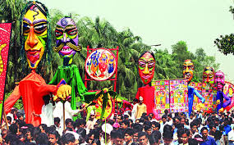
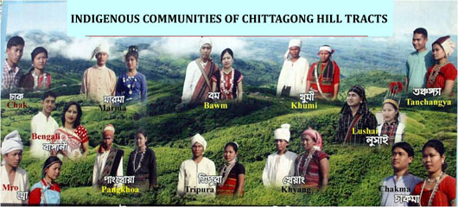
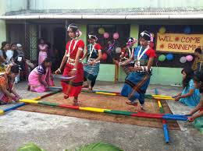
Bangladesh - a valued tourist destination
'Lonely Planet‘ puts Bangladesh in the list of most ten valued destinations of the world.
Being a young destination on the world tourism map and her attractions still less trodden, it possesses a great potential to attract tourists and investment from all over the world.
Bangladesh is always ready to welcome tourists in this land of virgin lush green and ancient civilizations.

Slide 4

Major Tourism Attractions of Bangladesh.
Cox’s Bazar ;
Sundarbans;
Dhaka- the capital ;
Three Hill Districts: Bandarban. Khagrachhari and Rangamati ;
Sylhet ;
Tangua Haor;
Chittagong;
Kantajeu Temple, Mainamati, Mahasthangarh, 60-domed Mosque,
and Paharpur archaeological site over period from 300 BC to 7-8 AD.
Over seven hundred tourists spots.
A unique tourist destination to find all kinds of interests & investment.
Peoples are resilient by nature with smiling face.
If Malaysia represents Truly Asia, Bangladesh represents Truly Asian Hospitality.

Slide 5

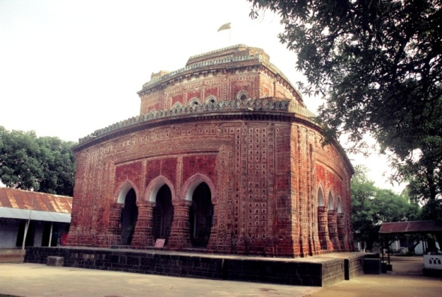
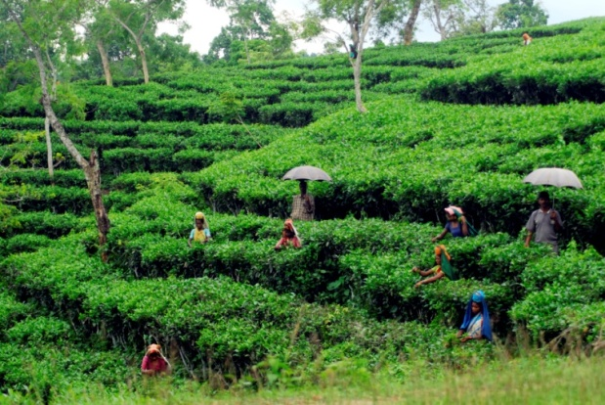
Mangrove Forest - Sundarbans
Sixty-Dome Mosque, Bagerhat
Kantajew Temple, Dinajpur
Tea Garden, Sylhet
Ahsan Manjil, Dhaka

Slide 6

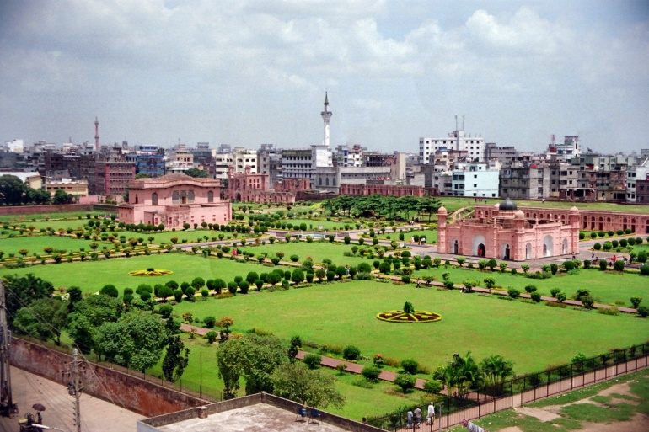
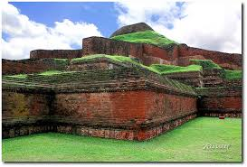
Gokul Medh, Mahasthangar, Bogra
Tribal Culture
Lalbagh Fort, Dhaka
Paharpur World Heritage Site, Naogaon

Slide 7

Govt. Plans, Policies and Programs
Tourism Policy, 2010 : CBT, Eco-tourism, Youth Tourism, Religious Tourism
‘Exclusive Tourist Zone and Tourism Protected Area’ Law , 2010 : 35000 acres Land notified.
Industrial Policy, 2005 declares tourism as a thrust sector.
Multi-faceted initiatives to attract foreign investment.
Creation of tourism human resources stressed : NHTTI
Strong public-private partnership (PPP) emphasized;
Bangladesh Tourism Board (BTB) works for overseas tourism marketing and promotion ;
Tourist Police deployed.
Visa and immigration formalities simplified (Bangladesh offers Visa on Arrival to 64 countries till date);

Slide 8

Tourism and Economic Zones
Development of exclusive tourism facilities or one stop service for tourists within specific areas like economic zone is a popular concept. It is also very successful in many countries.
Bangladesh experiences for tourism development in the form of economic zone is still at nascent stage. Very recently efforts have been taken by BEZA in this regard.
Cox's Bazar and Chittagong are the two most import tourism zones abundant with natural tourist attractions. These two districts are widely and most frequently visited tourism sites.

Slide 9
Contd.
The comprehensive tourist facilities are yet to be developed in Chittagong and Cox’s Bazar. What the facilities that have already been developed are scattered. The facilities are only hotels, motels, bar, swimming pool etc.
To attract more tourist facilities, we need to develop more facilities of international standard. Here, tourism economic zone are a good concept.
Tourists can find all kind of facilities within the same place without any hassle. Foreign tourists can fly in and out directly without facing the traffic congestions.

Slide 10
Contd.
Bangladesh Parjatan Corporation has created some facilities in Cox's Bazar and Chittagong, which are not sufficient. To have more economic gain, tourism economic zone can open up many windows with positive socio-economic impact.
Here to mention the name of Sabrung and Naf Tourism Parks are effective initiatives. If investment is made, Bangladesh can attract more foreign tourists.
BEZA and BPC need to work in a more coordinated way for development of tourists facilities in Cox's Bazar and Chittagong and other economic zones.
In Sabrung Tourism Park, BEZA may ensure BPC’s stake by allocating a plot for creating recreational activities or in some other manner.

Slide 11
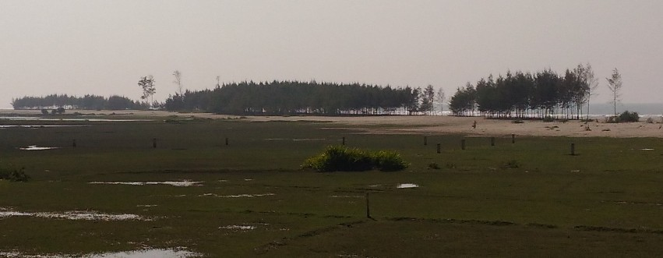
Tourism in BEZA’s Goals
BEZA can establish –
‘Special Economic Zones privately or by public- private partnership or by the Government initiative, for the establishment of any kind of specialized industry or commercial organization’.
    (BEZA Act, 2010: Section 4(d))
Sabrang Tourism Park & Naf Tourism Park are being developed by BEZA for specialized tourism industry.

Slide 12
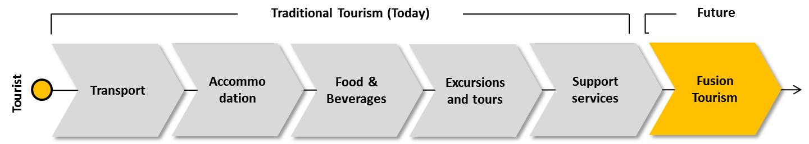
Objectives of the Development of Tourism Park
Industry diversification
Development of a new national growth engine
Creation of a tourism corridor in Cox’s Bazar region

Slide 13
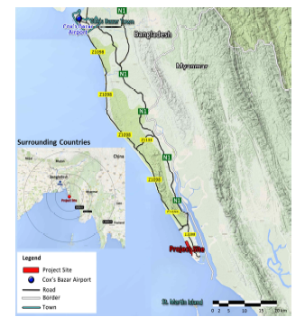
Sabrang Tourism Park
Located at the Tourism Hub of Cox’s Bazar
KEY FACTS
Location | 86 km South from the Cox’s Bazar Town 183 km from Chittagong town Located along the beach of Teknaf Peninsula
Area | 1027acres (416 ha)
Off-site Development Cost (Estd.) | USD 4,669,551
Major Development Works | Earthwork, Road & Pavement, Water Supply, Sewerage, Power Supply
Employment Generation | 100 thousands (direct and indirect)

Slide 14
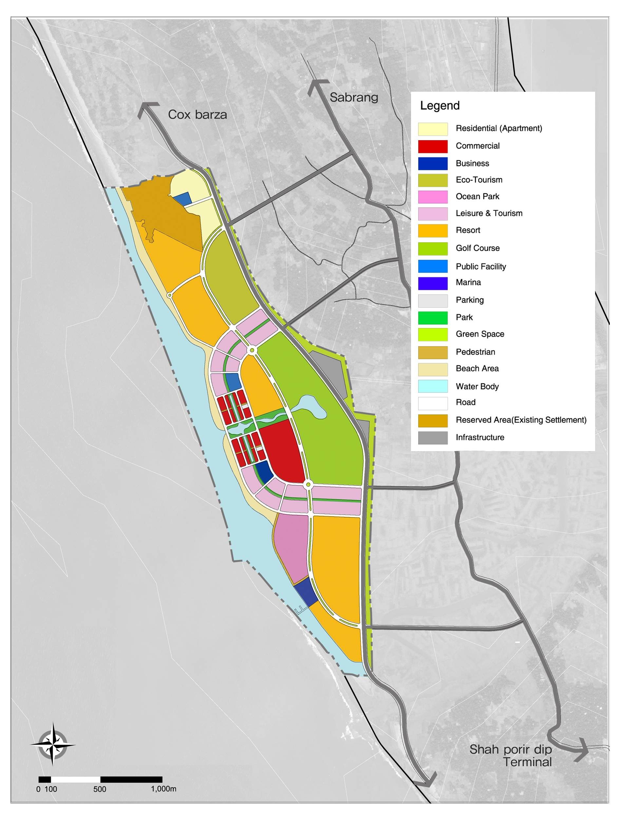
Master Plan
Land Use Plan
DESIGN FEATURES
Strong attractions
→ Such as Casino and Ocean Park
Large Green and Open Spaces
→ Make relax and natural setting
Vibrant Waterfront Environment
→ Synergy between beach and commercial areas
Reserved
Resort
Eco-
Tourism
Golf
Course
PROGRAM
Casino
Land Use | Area(㎡) | %
Total | 4,158,000 | 100.0
Tourism | 1,786,000 | 42.8
Commercial | 189,000 | 4.6
Residential | 104,000 | 2.5
Public Facility | 59,000 | 1.4
Open Space | 1,241,000 | 29.8
Others | 783,000 | 18.9
Hotel
Ocean
Park
Resort
Marina
Notes:
We created the land use plan based on 3 design features.
Sabrang needs strong attractions so that we introduce Casino, Ocean Park and golf course there.
Sabrang has large green and open spaces so that people can enjoy relax and natural setting.
Sabrang has the vibrant waterfront environment. There is synergy between beach and commercial areas.
According to these features, Tourism and open space are the largest land uses in this plan.

Slide 15
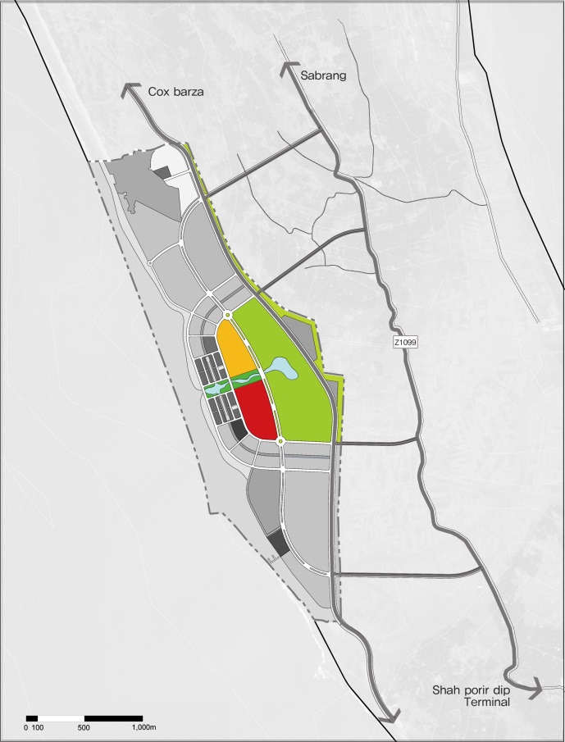
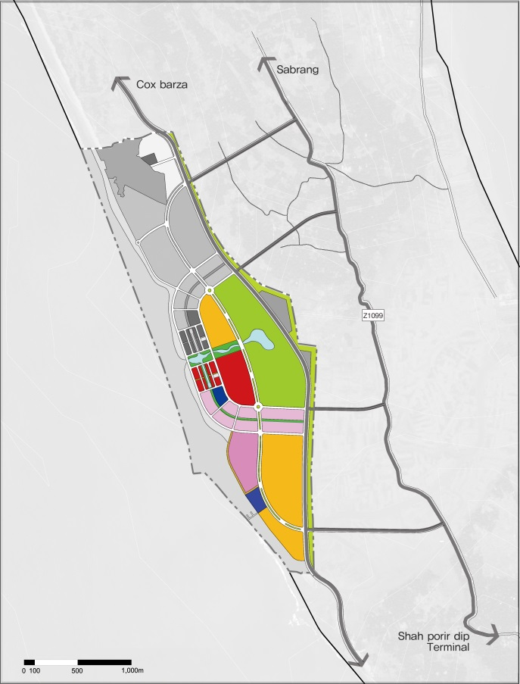
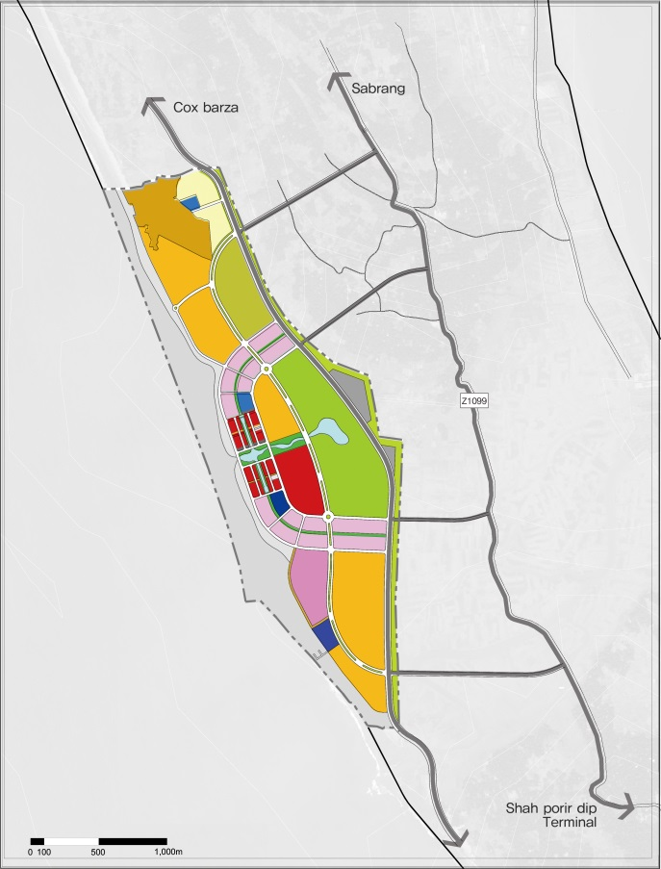
Sabrang: Phased Development
Phased Development
PHASE 1 : Beginning with Competitive Facilities
PHASE 2 : Establishing an International Tourism Park Image
PHASE 3 : Completion of the Sustainable Tourism Park
Place anchor facilities that attract international tourist
Generate initial profit from strong attractions
Key facilities : Casino, Resort, Golf Couse
Provide family-oriented facilities to widen target ages
Provide a ferry service to help tourists visit easily
Key facilities : Marina, Ocean Park, Hotel
Provide the Eco-Tourism place for ecological/cultural conservation
Establish a residential area to accommodate a certain portion of employees’ families
Key facilities : Residential, Eco-Tourism
Notes:
Now we need to consider how to develop the site efficiently.
We propose 3 phases of development.
Phase 1 is to begin with competitive facilities so that we choose the central place having Casino and golf course.
Phase 2 is to focus on building up the international tourism park image so that we target family-oriented facilities such as ocean park and introduce the marina service to attract international family tourists.
Phase 3 is to complete the tourism park with sustainable functions such as eco-tourism.

Slide 16
Functions and Facilities
Casino
Ocean Park
Golf Course
Hotel , Resort
Eco Tourism
Shopping Mall
Adventure
Facilities in Sabrang TP

Slide 17
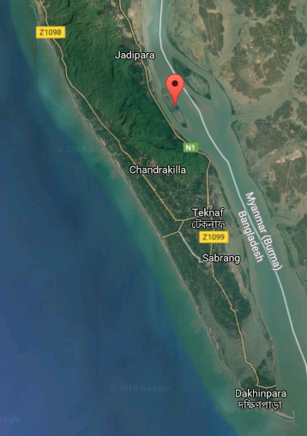
Naf Tourism Park
Developing on Jaliardwip - Green Pearl of Naf River
KEY FACTS
Location | 82 km South from the Cox’s Bazar Town 179 km from Chittagong town An Island of Naf River
Area | 271.93 acres
Off-site Development Cost (Estd.) | USD 17.93 m
Major Development Works | Earthwork, Hanging Bridge, Access Road, Water Supply, Sewerage, Power Supply
Employment Generation | 50 thousands (direct and indirect)

Slide 18
Jaliardip – Eco-Tourism Potential
Surrounding Future Tourism Areas
River and Connection Channel

Slide 19
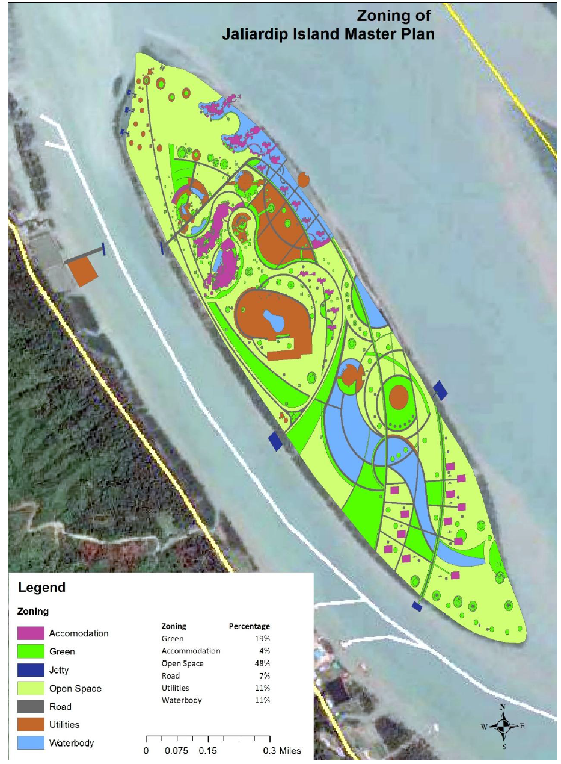
Master Plan - Zoning

Slide 20
Request for Proposal for Naf Tourism Park has been issued
Last date of Bid submission: 02 March, 2017

Slide 21
Investment Opportunities in Tourism
Prevailing an investment-friendly climate.
Bangladesh offers lucrative and competitive opportunities for foreign investment.
Possesses geo-political advantages for foreign investment.
Broader connectivity raises the competitiveness of a potential destination among the South-East Asia.
Well-connected with all major destinations of the world. Many luxurious and low-cost airlines operate their flights.

Slide 22
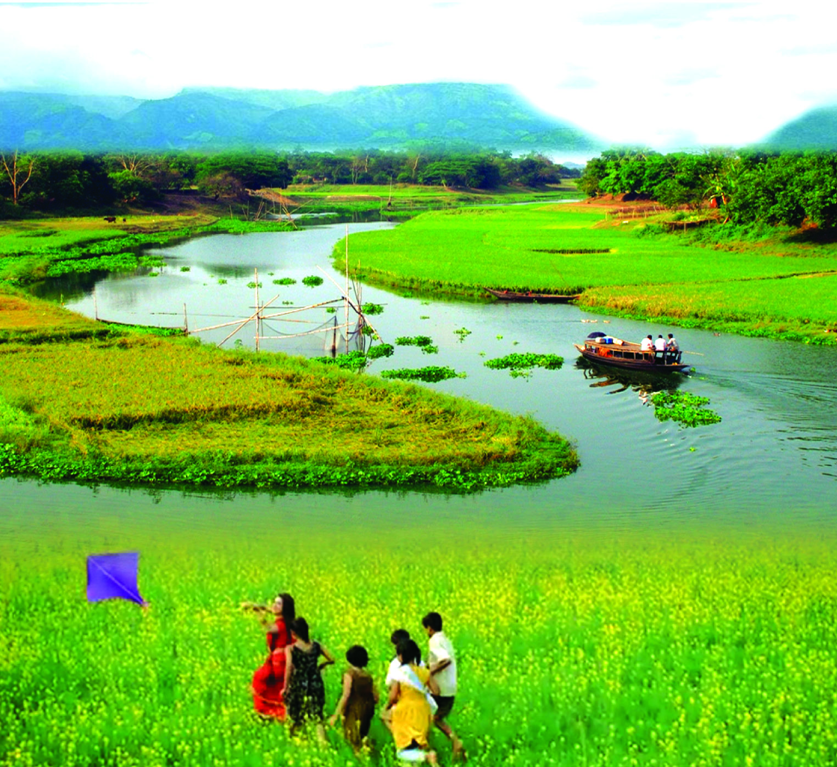
Thank you

